Slide 1
Book Library Project
Monica Lalor, Mikayla Kantorski, Kaleigh Andrzejewski, Angela Gardner
Project Website
Source Code Website

Slide 2

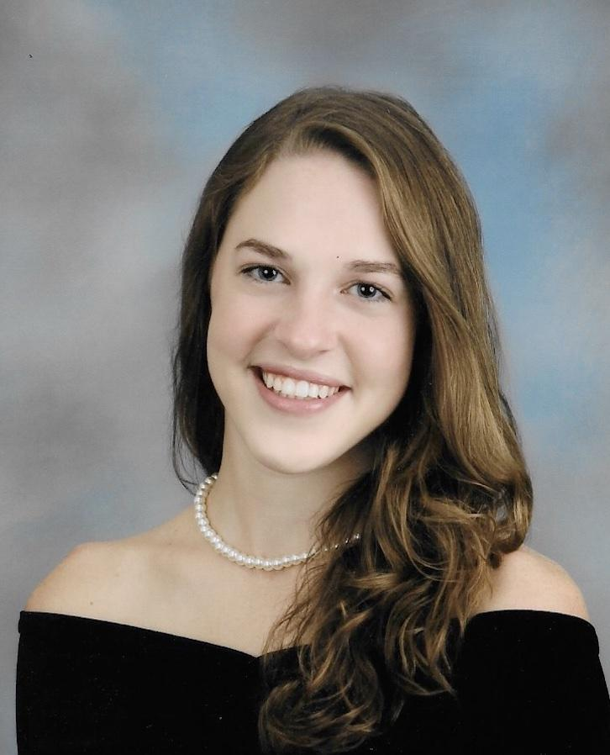
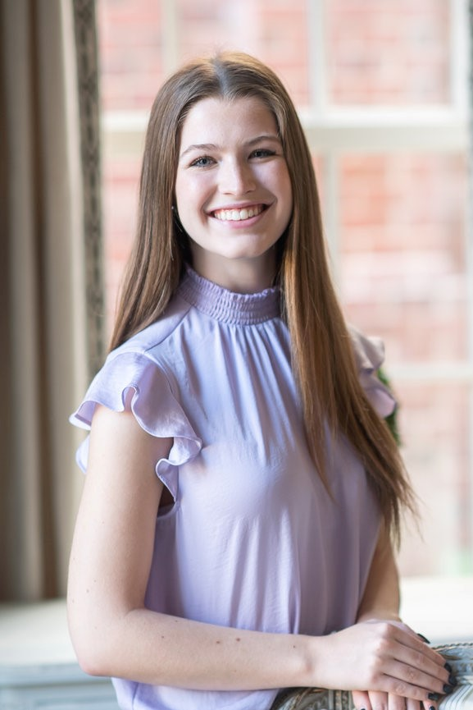
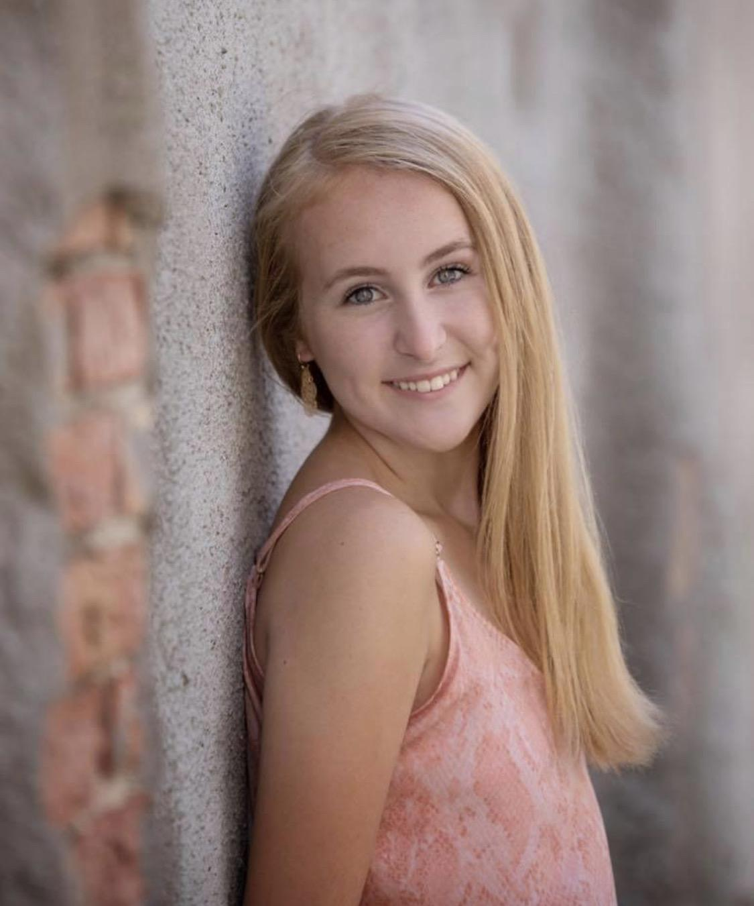
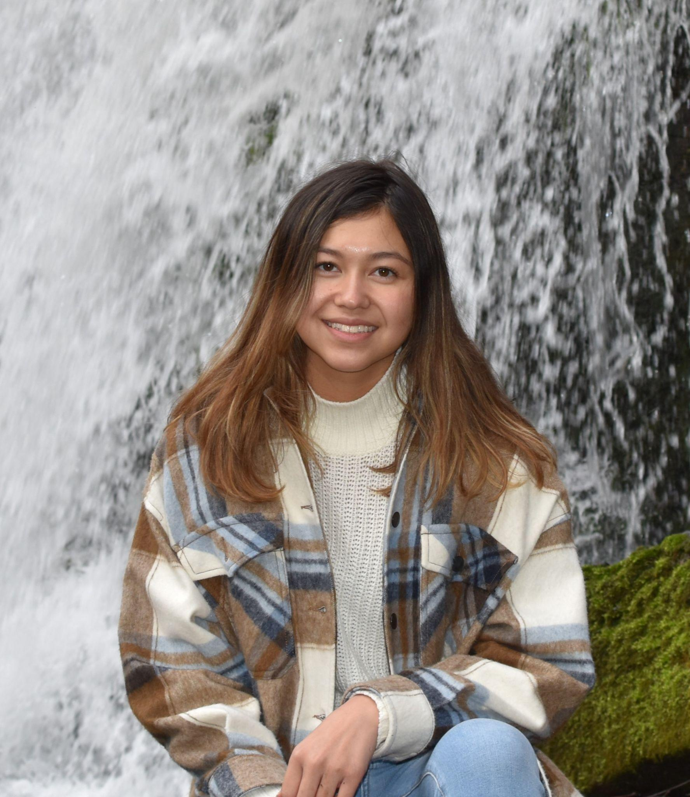
Team Members
Angela Gardner
Kaleigh Andrzejewski
Monica Lalor
Mikayla Kantorski
Notes:
Angela

Slide 3
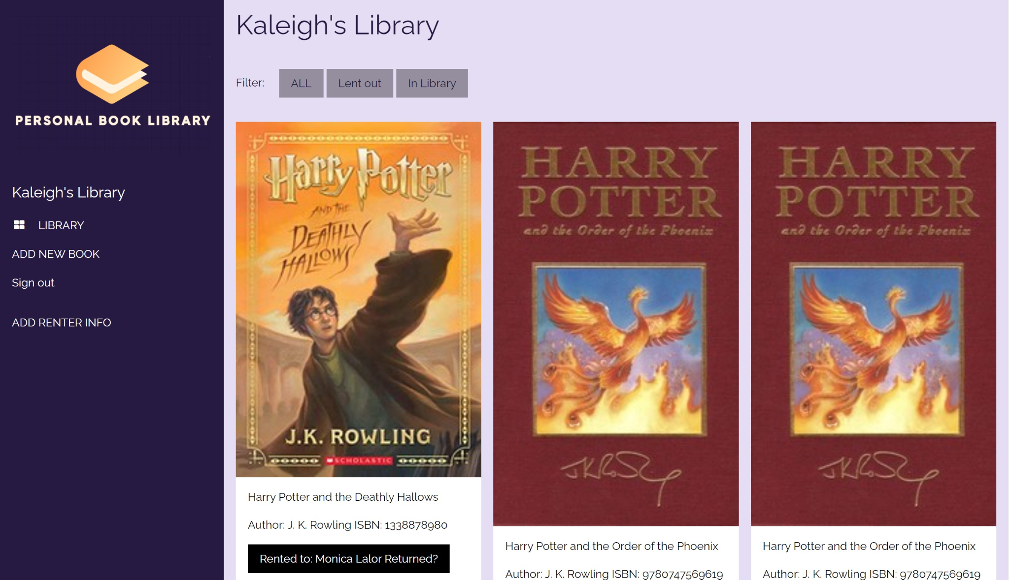
Project Overview
Easily manage the library, track loans, and send email reminders
Create a web interface personal book library where books can be added, removed, and loaned
Notes:
Angela

Slide 4
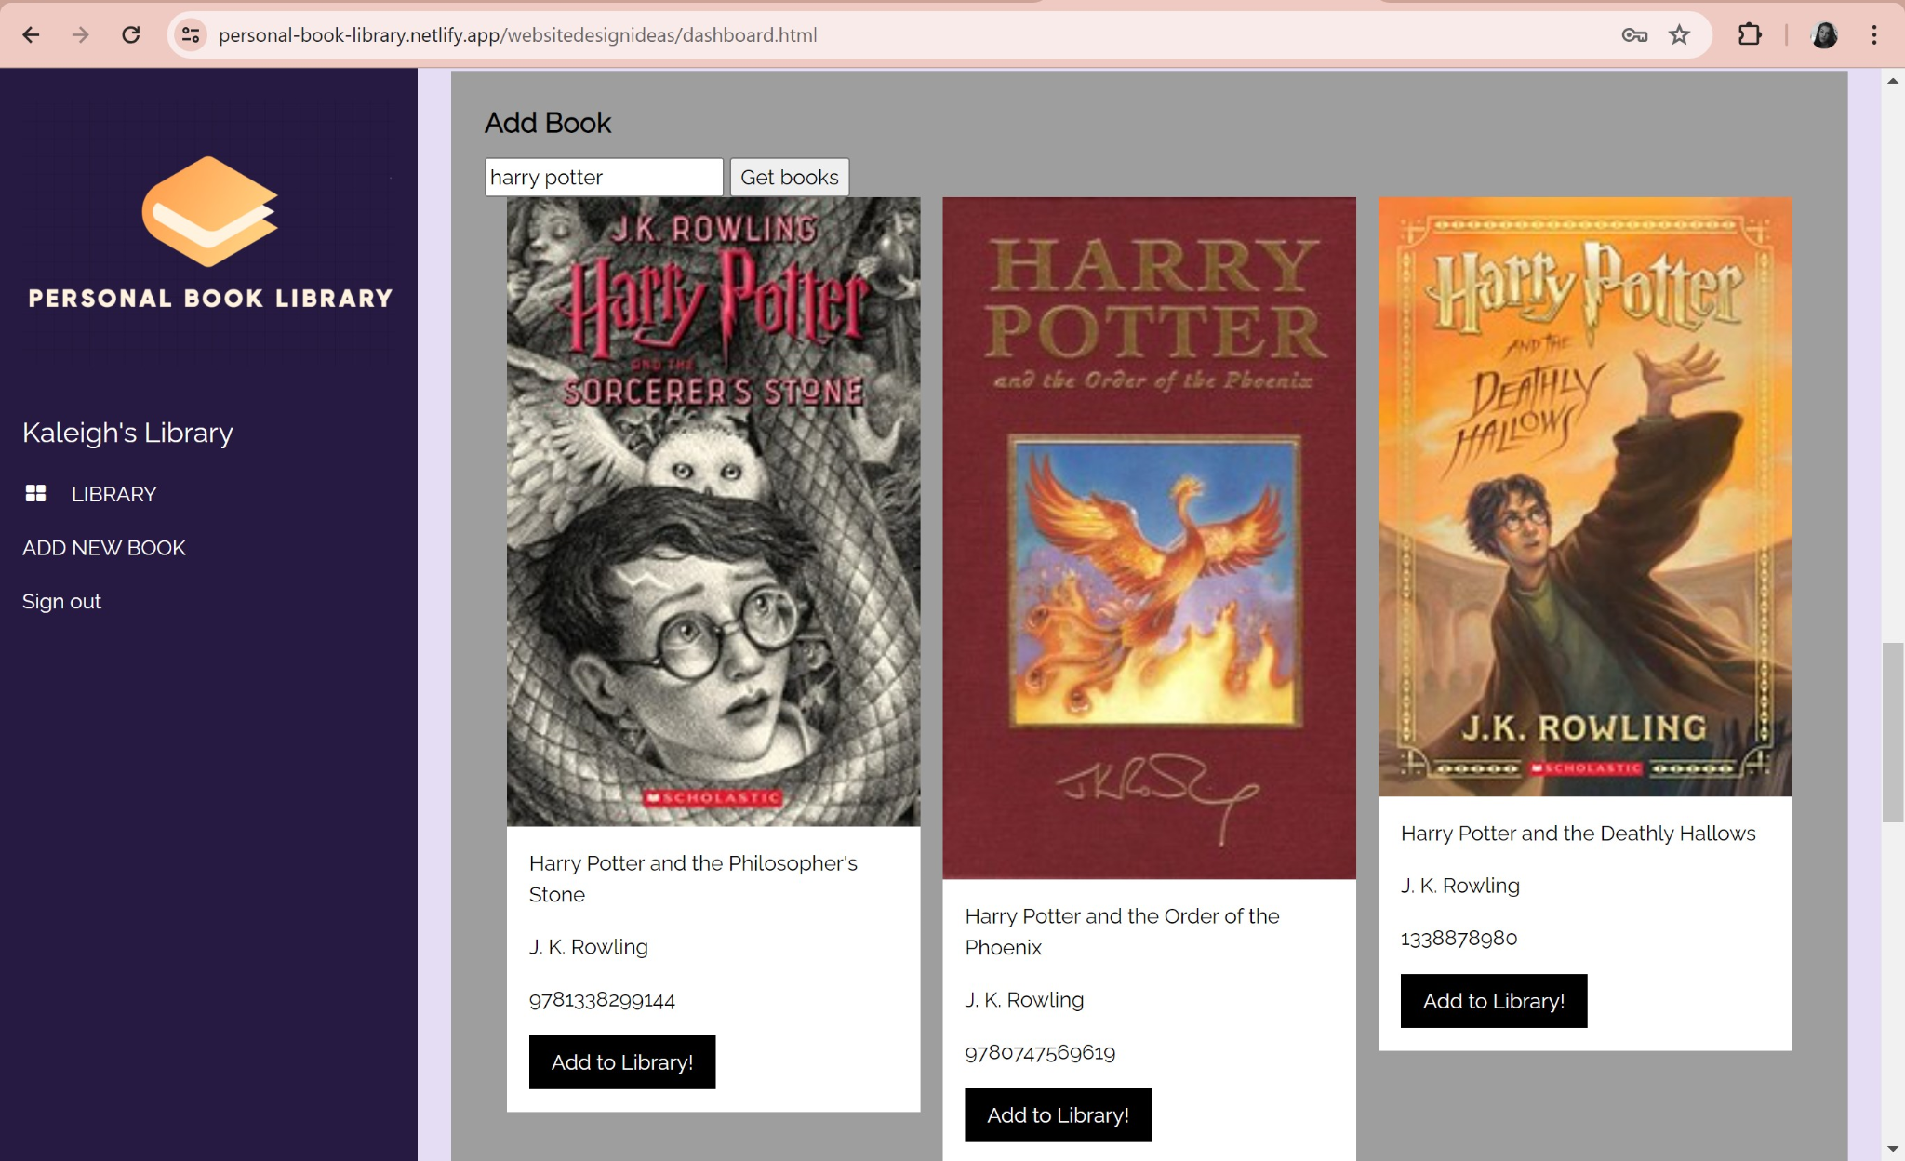
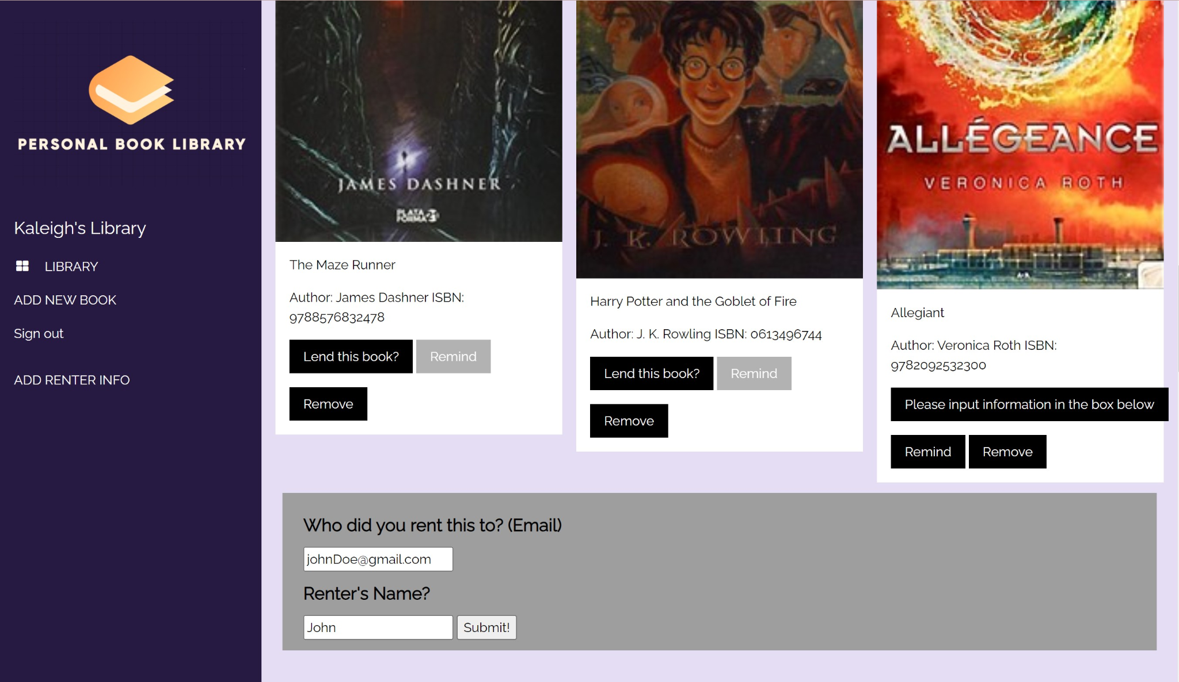
Functionality
User registration/login
Search book database
Add books to library
Rent out books, storing email/name of renter
Check status of book
Send reminder email button
Mark book returned
Notes:
Monica Lalor

Slide 5
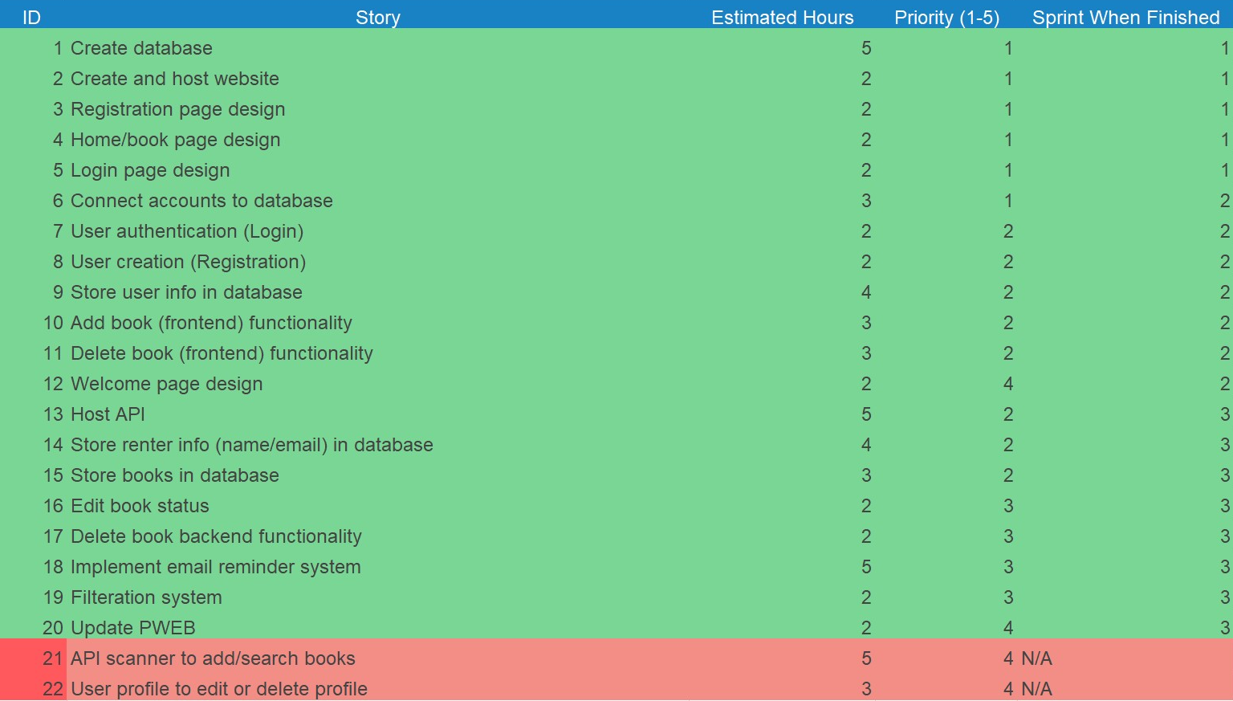
Significant Backlog
Search for books
Remove Book Button
Storing Books in database
Storing Renter Info
Registration/Login
Login security
Remind Functionality
Hosting Website/API
Notes:
Monica Lalor

Slide 6
Contributions and Reflections
Monica
Contributions: Frontend design and functionality, Integration of APIs
Learned: Web Development and API integration
Hardest Part: Working with the backend after the front end was already set up in a specific way
Mikayla
Contributions: Frontend functionality, Cybersecurity implementations
Learned: Web development with Javascript, connection of backend/frontend
Hardest Part: Working with new tools in our framework
Kaleigh:
Contributions: Frontend/Backend connection, Hosting API, Frontend troubleshooting
Learned: Host an API, .NET
Hardest Part: Learning how to combine frontend and backend
Angela:
Contributions: Frontend functionality, Integration of APIs
Learned: Website development, script communication
Hardest Part: Implementing features natively incompatible with HTML
Notes:
Everyone do their own contributions

Slide 7
Live Demo!
https://personal-book-library.netlify.app/
Notes:
Kaleigh

